Slide 1
Unmanned Aerial Vehicle (UAV)
PRESENTED TO:
PROFESSOR JAHAN GHOFRANIHA
PRESENTED BY:
ARYAN JADON ( 015260609 )
HARIKA NALAM ( 015939963 )
SHREYA NIMBHORKAR ( 015226315 )
SWATHI ANANDRAM ( 015923804)

Slide 2
Agenda
What is Unmanned Aerial Vehicle (UAV) and Why do we need them
What is Unity and How Unity ML-Agents help in Reinforcement Learning
Components of Unity ML-Agents
Proximal Policy Optimization (PPO)
Learning Environment for Agent
Project Demo

Slide 3
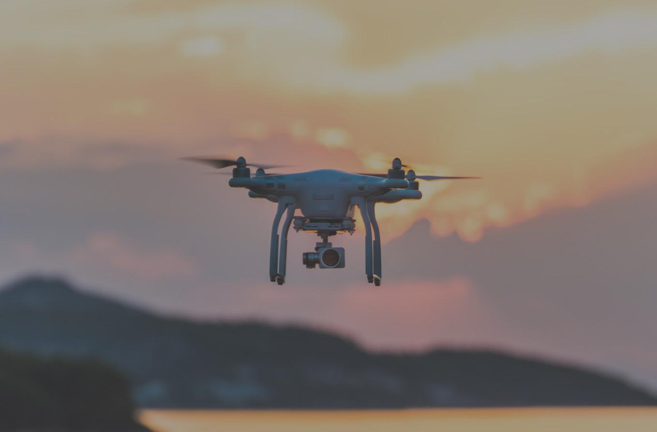
What is UAV and Why UAV?
An Unmanned Aerial Vehicle (UAV) is an aircraft without any human pilot, crew, or passengers on board.
UAVs have the characteristics of fewer use restrictions, no casualties, good concealment, and high cost-effectiveness, which can be used in intelligence and surveillance.

Slide 4

Unity and Unity ML-Agents
Unity offers tools to create virtual simulated environments with customizable physics, landscapes, and characters.
Unity ML-Agents is a new plugin for the game engine Unity that allows us to create or use pre-made environments to train our agents.

Slide 5
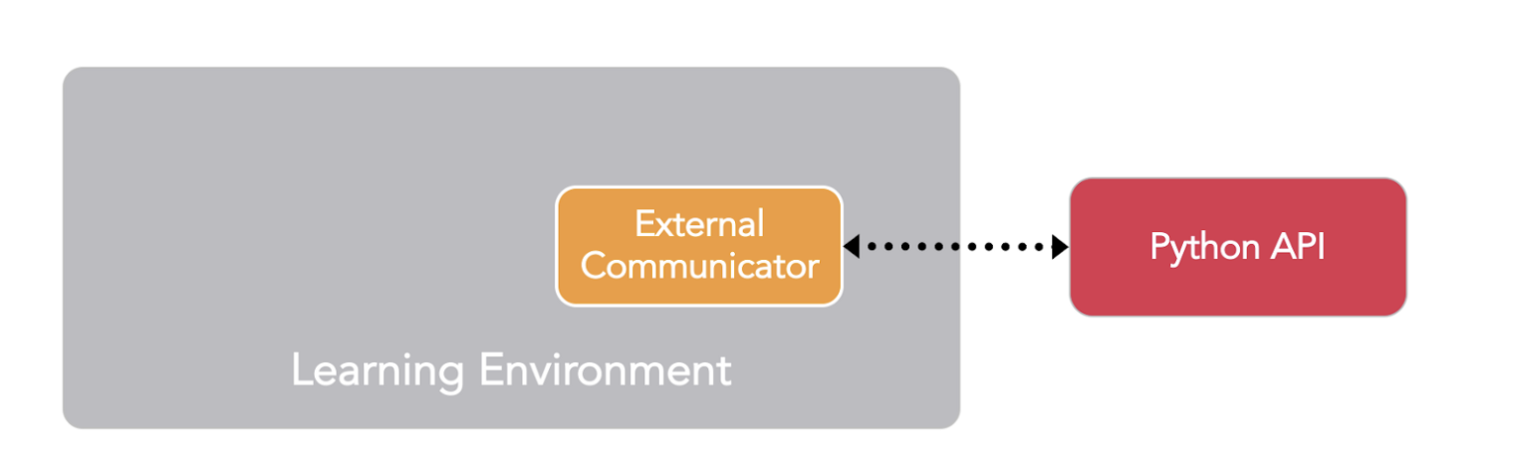
Components of Unity ML-Agents
Learning Component
Python API
External Communicator

Slide 6
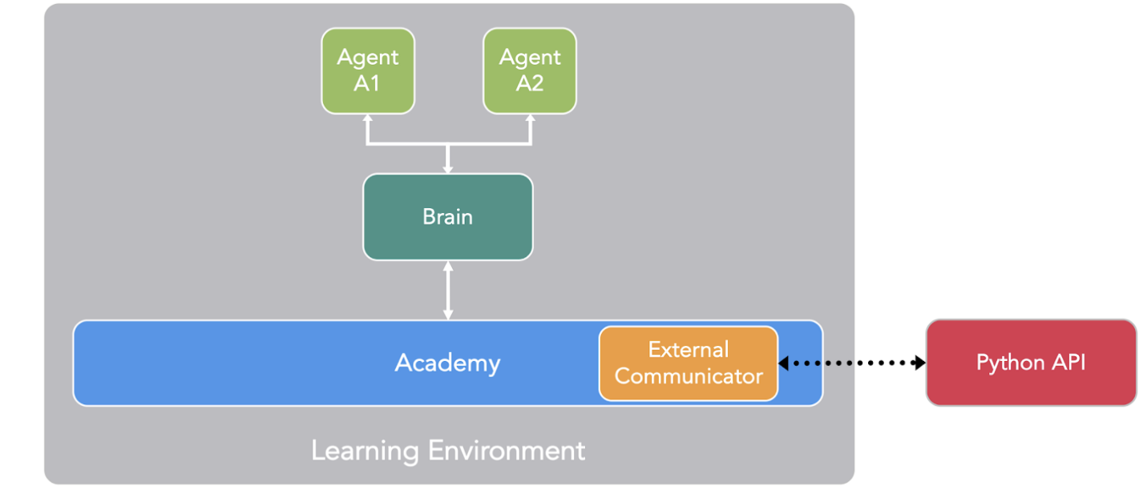
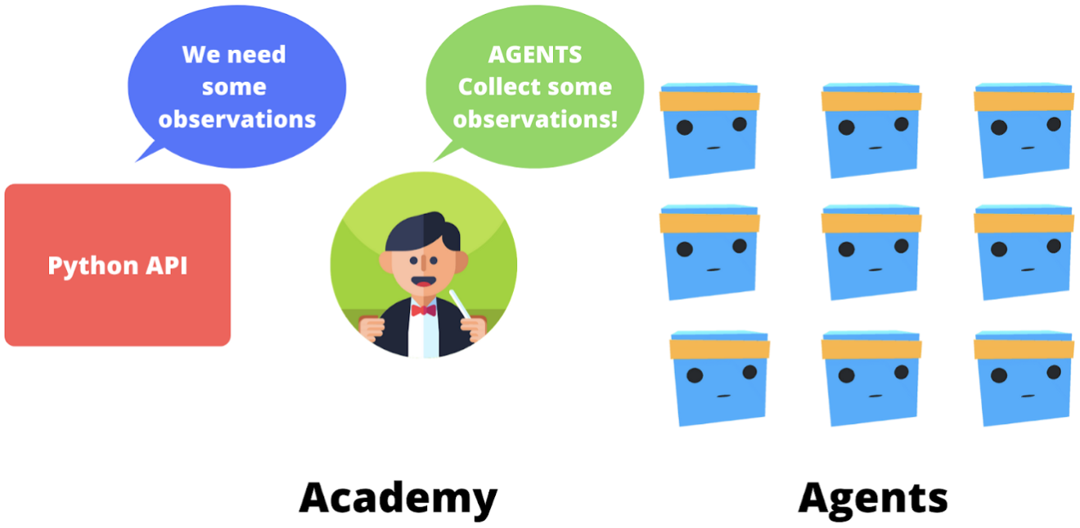
Components inside Learning Environment

Slide 7
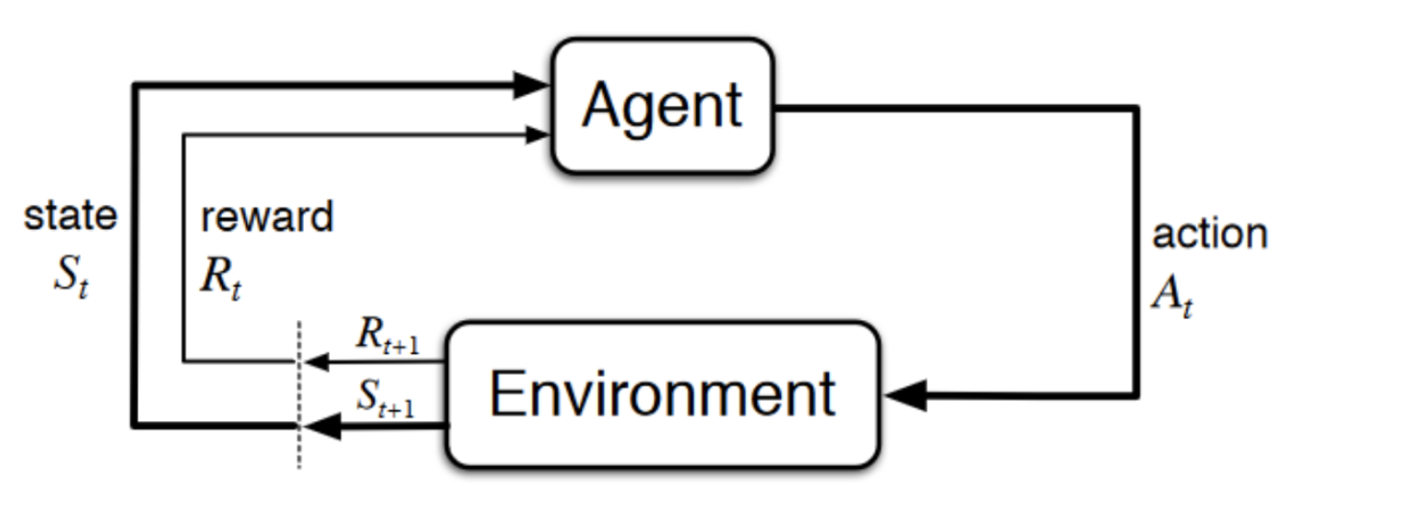
Platform Game Example

Slide 8
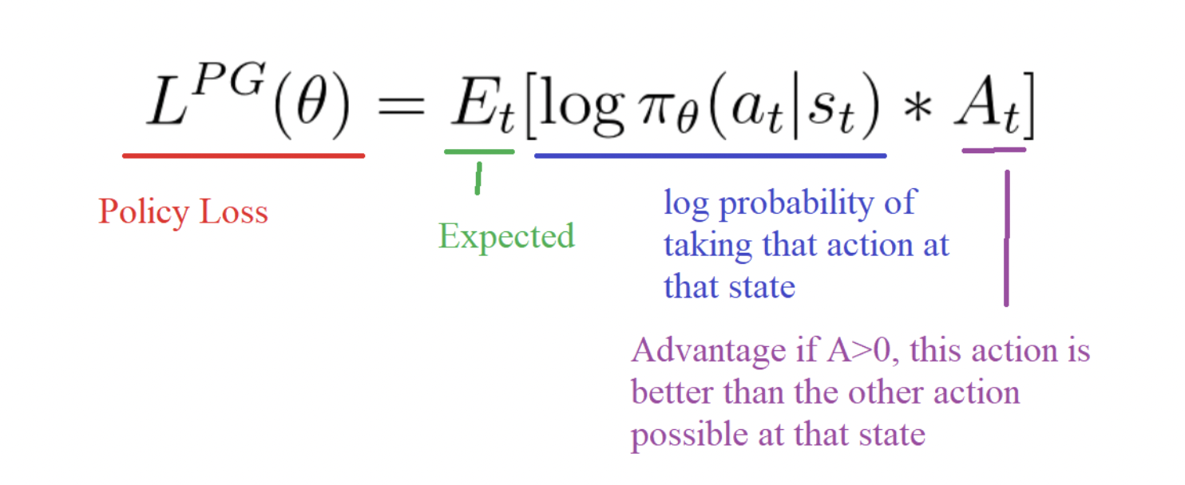
State of Art Algorithm : Proximal Policy Optimization (PPO)
Traditional Policy Gradient objective function :
If step size too small - training process becomes too slow
If step size is too large - too much variability in the training process

Slide 9
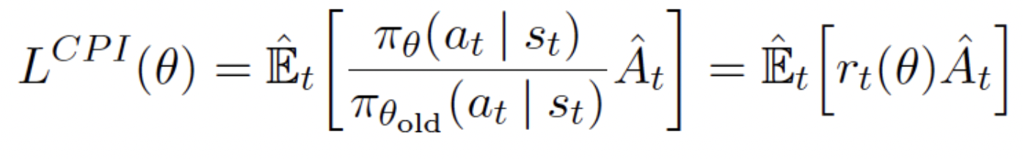
State of Art Algorithm : Proximal Policy Optimization (PPO)
Trust Region Policy Optimization(TRPO):
TRPO adds constraints to limit policy update however it also adds overhead to optimization process and sometimes lead to undesirable training behaviour

Slide 10
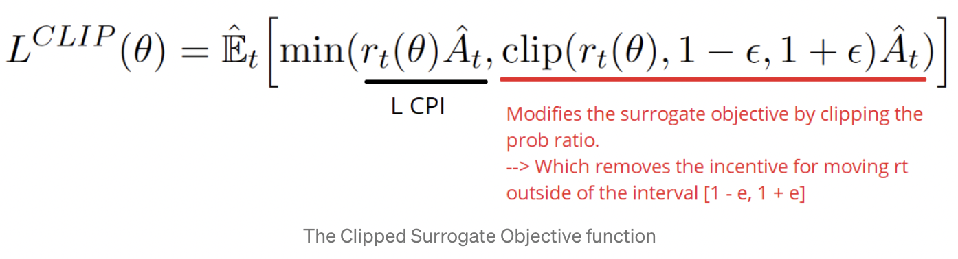
State of Art Algorithm : Proximal Policy Optimization (PPO)
PPO :
Includes restriction constraint directly in the optimization process.
Restricts the range that the new policy can vary from the old one.
Core purpose - strike a balance between ease of implementation, sample efficiency and ease of tuning.

Slide 11
State of Art Methods in Unity
Proximal Policy Optimization(PPO) | Soft Actor Critic(SAC)
On-policy | Off-policy
Less sample efficient | Sample efficient
Training converges to near optimum | Less experiences collected and algorithms go through them multiple times
More stable | Less stable
Good for all environments | Good for changing environments

Slide 12
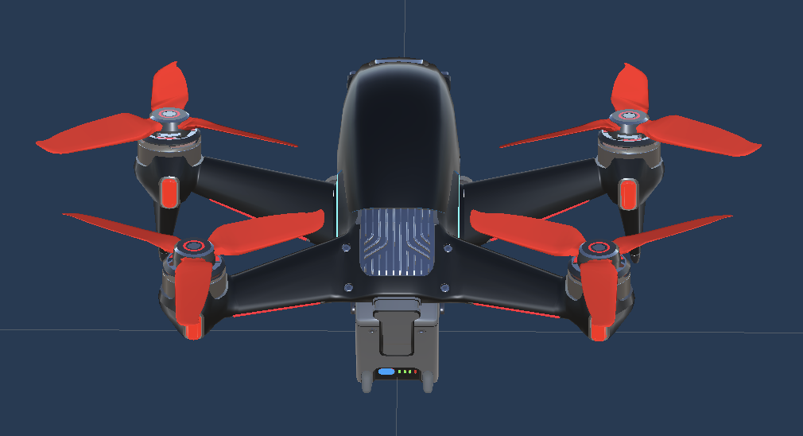
Learning Environment for Agent
The important components in unity reinforcement learning environment are
Behavior Parameters
  Actions
  Model
  Behavior Type
    Default(Learning Behavior)
    Heuristic
    Inference
Decision Requester

Slide 13
Training Process Steps
OnEpisodeBegin() - Agent in the scene
CollectObservations(VectorSensor sensor) - collecting observations
After collecting observations, uses policy to decide next action
OnActionReceived() - passing action received by agent’s policy
If reached its max steps in the scene OnEpisodeBegin() is called or otherwise marked itself as EndEpisode()

Slide 14
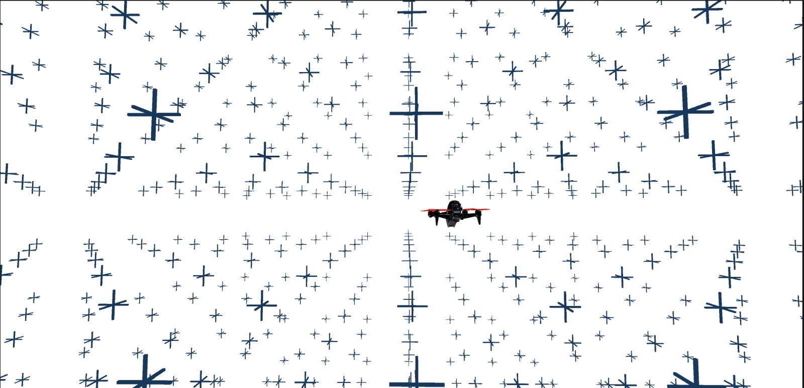
Rotor Controller Scene
  ‘X’ - tags/ obstacles
  Camera - camera follows the agent

Slide 15
Project Demo

Slide 16

Video Link - https://drive.google.com/file/d/1B82DRj2fhIglXJuTbn6se6TJknsprw8o/view?usp=share_link

Slide 17
Thank You

